Slide 1
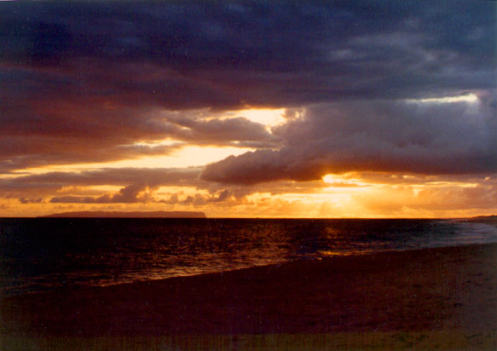
STANDARD-FREQUENCY AND TIME-SIGNAL RADIO
The Stations That
Broadcast Time Itself
WWV, WWVH and WWVB — and the world's other time stations, past and present
Presented by ______________________
Credit: NIST
Notes:
Replace the 'Presented by' line with your callsign and club.
Open by asking who has ever tuned 5 or 10 MHz and heard the ticks. In most rooms it is a lot of hands, and most of them have never known what all the tones actually mean.
The promise: by the end you will know exactly what you are hearing, second by second, and where the rest of the world's time stations are - including the ones that have gone.

Slide 2
AGENDA
What this covers
1
What a time station actually does
The product is not a program. It is precision.
2
How they modulate
AM you can listen to, keying you cannot, and some plain Morse
3
The American trio
WWV, WWVH and WWVB
4
WWV itself
The oldest voice on the air, and how close it came to ending
5
Around the world
Who else is still transmitting time
6
Silent now
The ones we have lost — including one this year
Notes:
Item 6 always gets a reaction, so flag it here. CHU went off the air in June 2026 and a lot of operators still do not know.

Slide 3
WHAT THEY DO
Their product is not a program. It is precision.
A time-and-frequency station is built around an atomic clock, and everything it sends is locked to that clock.
THE CARRIER
ON TOP OF IT
A standard frequency
The time
Tune a receiver to WWV on 10 MHz and you have a 10 MHz reference good to a fraction of a part per billion — accurate enough to calibrate a lab oscillator.
A tick every second
A tone at the minute
A spoken announcement of the hour
A digital time code a chip can decode
A chronometer check for mariners, a calibration reference for engineers, and the reason your kitchen clock sets itself twice a year.
Notes:
Land this line: the carrier itself IS the product. Everything else is decoration on a perfectly steady frequency.
For a ham audience, the calibration angle lands hardest - generations of operators zero-beat their rigs against WWV.

Slide 4
THE ATOMIC CLOCK
The clock behind the tick
Since 1967 the second has not been a fraction of a day. It has been a count of oscillations in a caesium atom.
1
Three caesium standards, on site
ONE SECOND =
WWV and WWVH each hold three commercial caesium oscillators in three separate racks. One is designated the site master, and it drives the time code generator that feeds every transmitter.
9 192 631 770
cycles of the radiation from the hyperfine transition of an unperturbed caesium-133 atom.
2
Checked against Boulder every working day
The station standards are compared with UTC(NIST) in Boulder by GPS common-view measurement and steered when they need it. Station frequency is held to within a few parts in 10¹³.
Count to that number and a second has passed. Nothing about the Earth is involved.
3
Transmitted almost perfectly. Received rather less so.
At the transmitter the time is within 0.0001 ms of UTC. By the time it reaches you it is good to under 10 ms — the loss is path delay, and it varies by up to a millisecond as the signal bounces off the ionosphere.
The error is in the path, not in the clock.
Everything that limits what you can do with WWV happens after the signal leaves the antenna.
Notes:
The definition is the slide's anchor. Before 1967 a second was a fraction of a day, and the day is not constant. Caesium replaced the Earth as the reference - and the number was chosen to match the old astronomical second as closely as anyone could measure it, which is why 9 192 631 770 is such an odd figure.
A caesium standard does not 'tick'. It is a microwave oscillator locked to that atomic resonance, and the electronics divide down to produce a one-second pulse.
The station clocks are commercial caesium standards, not primary standards. The primary standards live in Boulder - NIST-F1, NIST-F2 and now NIST-F4, which was accepted in 2025 as one of the small group of clocks worldwide that help define international time. Those are caesium fountains, accurate to a few parts in 10 to the sixteenth. Popular accounts round that to 'one second in a hundred million years'; you will also see 140 million quoted. Use the round figure and do not defend the digits.
The last step matters most to a ham audience. The transmitted time is essentially perfect. Under 10 ms received is not the clock failing - it is roughly 5 ms of travel time for every 1000 miles, plus ionospheric wander. Anyone using WWV for real timing corrects for path delay.

Slide 5
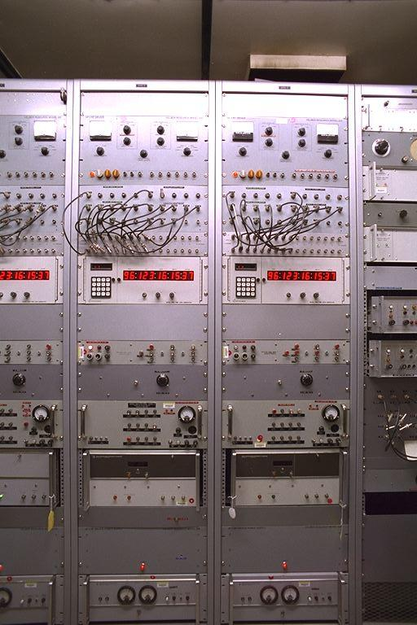
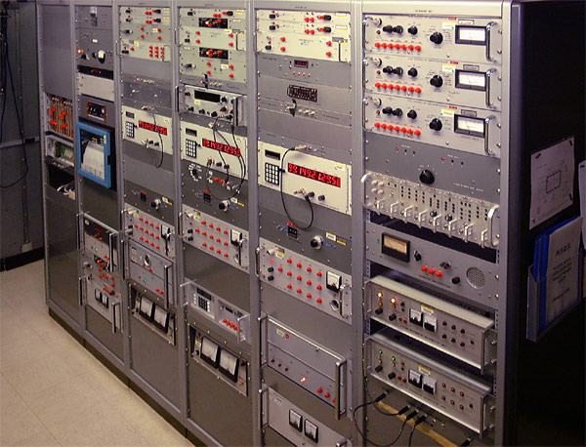
THE CLOCK ROOMS
Three racks at each station
Fort Collins. The clock rack at WWV — the standards themselves, and the equipment that compares them.
Kauai. WWVH's time and frequency rack: digital recorders, a multi-channel chart recorder, and the station clocks.
One of the three is designated site master. It drives the time code generator, and that feeds every transmitter in the building.
Credit: NIST
Notes:
Worth pausing on. People picture an atomic clock as a single exotic object; it is a rack of commercial equipment in an ordinary room, and there are three of them so that any one can be checked against the other two.
The chart recorder in the Kauai photograph is the giveaway that these are working instruments, not exhibits.

Slide 6
WHAT THEY DO
Two families, two jobs
SHORTWAVE (HF)
LONGWAVE (LF)
Heard across oceans
Punch through walls
WWV · WWVH · CHU · BPM · RWM
WWVB 60 kHz · DCF77 77.5 kHz · MSF · JJY
For generations this was how a ship checked its chronometer and a ham calibrated a rig.
They do not travel as far — which is exactly what a self-setting alarm clock on a nightstand needs.
The earliest of all were a U.S. Navy experiment — the Naval Observatory was sending wireless time signals as a navigation aid by about 1904, two decades before broadcasting began.
Notes:
The 1904 date surprises people. Time signals predate broadcast radio by twenty years - the very first thing anyone did with a transmitter, after messages, was send the time.
The distinction to hold: HF for distance, LF for penetration. It explains every design choice that follows.

Slide 7
WHAT THEY DO
Where they sit
20 kHz
60 kHz
77.5 kHz
162 kHz
2.5–20 MHz
3–15 MHz
WWVL
WWVB · MSF · JJY
DCF77
ALS162
WWV · WWVH · BPM
CHU (until 2026)
LONGWAVE
SHORTWAVE
Not to scale — the span from 20 kHz to 20 MHz is a factor of a thousand.
Notes:
Keep this quick - it is orientation, not detail. The point is that the two families live a thousand-fold apart in frequency and that is why they behave so differently.
Note 60 kHz appears three times: WWVB, MSF and one of the two JJY transmitters all share it, which is why clock chips built for one market often work in another.

Slide 8
HOW THEY MODULATE
The shortwave stations are AM you can simply listen to
WWV and WWVH use ordinary double-sideband, full-carrier amplitude modulation — exactly like an AM broadcast station. Which is why you can tune 5 or 10 MHz in AM mode and just hear them.
The tick
Every second. On WWV, five cycles of a 1000 Hz tone — about 5 ms long.
Telling them apart
WWVH sends its tick at 1200 Hz, so the two can be distinguished on shared frequencies.
The minute
A longer 800 ms tone marks the top of each minute.
The hour
A 1500 Hz pulse.
Reference tones
Steady 500 Hz and 600 Hz alternate through the hour.
The voice
A man on WWV, a woman on WWVH, reading UTC.
Notes:
If you can play a recording of WWV here, do. Thirty seconds of audio teaches this slide better than the slide does.
The 1000 versus 1200 Hz distinction is a lovely piece of engineering economy - two stations sharing five frequencies worldwide, told apart by ear alone.

Slide 9
HOW THEY MODULATE
Anatomy of one second
The on-time tick on WWV is literally five cycles of a 1000 Hz tone — about five thousandths of a second.
Why so short?
Because the tick has to be unmistakable and unambiguous. A short, sharp burst has a clean leading edge — and it is the leading edge that carries the time.
5 cycles of 1000 Hz ≈ 5 ms
The ticks and markers run at full modulation while the tones and voice sit lower — so the on-time tick always punches through.
Notes:
The audio engineering here is deliberate: everything else on the station is mixed down so the tick can never be masked. The one thing that must not be lost is the one thing given priority.
The drawing is schematic - five cycles at 1000 Hz really is about five milliseconds, which is far too short to see on any sensible scale.

Slide 10
HOW THEY MODULATE
Anatomy of one minute
0
one tick per second
60
800 ms tone
marks the top of every minute
1500 Hz pulse
marks the hour
500 / 600 Hz
alternating reference tones through the hour
100 Hz subcarrier
the digital time code, one bit per second, underneath it all
Notes:
The time code is the part nobody hears and everybody uses. It rides as a low-level 100 Hz subcarrier under the voice and tones - an extra tone you barely notice, but a clock chip reads it one bit per second.
That is the bridge to the longwave stations, which are nothing BUT that code.

Slide 11
HOW THEY MODULATE
The longwave clock-setters are keyed, not spoken
WWVB on 60 kHz carries no program at all.
It sends one bit per second, and nothing else.
That is amplitude modulation in the on-and-off sense — but fed to a speaker it would be clicks and hum, not something to listen to. Only a receiver chip decodes it.
Since 2012
Germany's DCF77
WWVB has layered a second, phase-modulated code on top for tougher reception.
Works the same way, and adds a phase-shift-keyed code that gives its signal a distinctive noisy hiss.
Notes:
If anyone in the room has ever heard DCF77 on a receiver, that hiss is what they remember. It sounds broken and it is not.
The key contrast with the previous slides: the shortwave stations are for humans and machines both. The longwave stations are for machines only.

Slide 12
HOW THEY MODULATE
How WWVB sends a bit
At the start of each second the carrier power drops 17 dB. What the bit means depends entirely on when the power comes back.
0.2 s
restored
0.5 s
restored
0.8 s
restored
ZERO
ONE
MARKER
carrier down 17 dB
One bit per second. Sixty seconds gives a clock chip the full time, date and daylight-saving state.
Notes:
Every 'atomic' clock in every kitchen in North America. The grey portion is the reduced carrier; the coloured portion is full power restored.
A nice aside: this is why those clocks usually update overnight. Sixty kilohertz propagates far better after dark, so the chip listens when reception is best and stays quiet the rest of the day.

Slide 13
HOW THEY MODULATE
And a few are just Morse
Russia's RWM and its relatives send interrupted-carrier markers and Morse identification.
Straight on-off keying. No AM envelope at all.
In every case, the point to remember:
The rock-steady carrier frequency is the standard. The AM, the keying, or the Morse is only the wrapper that carries the time.
Notes:
Close the modulation section on this, so let it land. Whatever the wrapper, the product underneath is identical: a frequency you can trust absolutely.
Send anyone with an HF receiver to listen to RWM - 4996, 9996 and 14996 kHz, and it has sounded the same for decades.

Slide 14
THE U.S. STATIONS
The American trio
All three are operated by NIST, with their clocks maintained by the Time and Frequency Division in Boulder, Colorado.
WWV
HF — 2.5, 5, 10, 15, 20 MHz
On the air since 1920. Male voice. Ticks, tones, spoken UTC, time code, and hourly geophysical and GPS-status announcements.
Fort Collins, CO
WWVH
HF — 2.5, 5, 10, 15 MHz
The Pacific sister station, since 1948. Female voice, so listeners hearing both can tell them apart.
Kekaha, Kauai, HI
WWVB
LF — 60 kHz
No voice at all. Since 1963, now 70 kW ERP — the signal that sets tens of millions of clocks.
Fort Collins, CO
Notes:
The man-and-woman distinction is the detail everyone remembers. WWV and WWVH share five frequencies, and on a good day you can hear both underneath each other - one male, one female, a second or so apart in propagation delay.
That is a genuinely lovely thing to demonstrate if you have a receiver in the room.

Slide 15
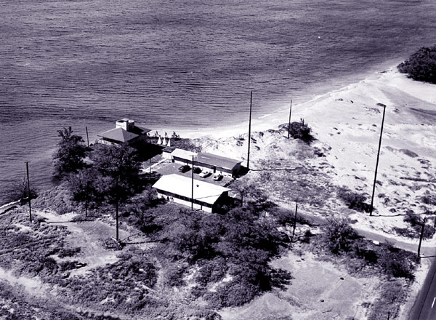
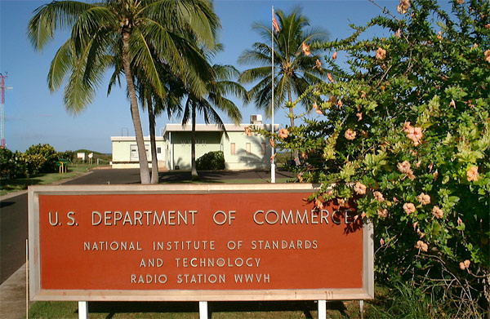
WWVH · THEN AND NOW
Twenty-three years on Maui, and then the move
Kihei, Maui, 1948 to 1971. The original WWVH, right at the water's edge — the reason the station eventually had to move.
Kokole Point, Kauai, today. The entrance sign inside the Pacific Missile Range Facility at Barking Sands.
Salt air is the villain of this whole story — on Maui it ate the station, and on Kauai it is why the antennas are fibreglass.
Credit: NIST
Notes:
The Maui photograph explains the move better than a sentence can. Look how close the buildings are to the surf.
WWVH went on the air from Maui in 1948 and moved to Kauai in 1971. The corrosion problem never went away; it is why the Kauai antennas were rebuilt in fibreglass between 2000 and 2007.

Slide 16
THE ANTENNAS
WWV's antennas: half-wave verticals
Five antennas, one per frequency, each with its own transmitter. Every one is a half-wave vertical radiating an omnidirectional pattern.
quarter-wave
radiating element
The elegant part
Only the top half is tower. The bottom half is nine quarter-wave wires from the tower's centre, sloping to ground at 45 degrees.
Those wires do two jobs at once — they radiate, and they hold the tower up.
Heights follow the frequency: about 60 m at 2.5 MHz, down to roughly 7.5 m at 20 MHz.
Each antenna has its own rigid coaxial feed — and the site is laid out so that no two lines ever cross.
nine wires, sloped 45°
they are the lower half of the antenna — and the guy wires
Power: 10 kW on 5, 10 and 15 MHz · 2.5 kW on 2.5 and 20 MHz · the intermittent 25 MHz outlet runs 2.5 kW
Notes:
The sloping-wire design is the detail antenna builders in the room will enjoy most. Nine wires doing double duty as radiator and guys is economical in a way that appeals to anybody who has ever put up a vertical.
The height range makes the frequency relationship physical: sixty metres at 2.5 MHz and about seven and a half at 20. Same design, eight times the size.
And the no-crossing-coax rule is a nice piece of discipline - five separate feeds across a field, deliberately routed so none passes over another.

Slide 17
THE ANTENNAS
How tall, and how much land
Antenna height is simply half a wavelength — so the whole field is one design built at six different sizes.
FREQ
WWV
WWVH
WHAT ABOUT THE GROUND SYSTEM?
2.5 MHz
60 m · 197 ft
30 m · 98 ft ¼λ
These are not quarter-wave monopoles standing on a radial field: the nine sloping wires are the lower half of the radiator, each about 0.354 of a wavelength. What lies under them is a separate question. A 10 kW site has a ground system — RF return, lightning, safety — and NIST does not publish what WWV's is.
5 MHz
30 m · 98 ft
30 m · 98 ft
10 MHz
15 m · 49 ft
15 m · 49 ft
15 MHz
10 m · 33 ft
10 m · 33 ft
20 MHz
7.5 m · 25 ft
—
THE LAND
25 MHz
6 m · 20 ft
—
Fort Collins — 158 hectares, 390 acres, shared by WWV and WWVB.
Kokole Point, Kauai — 30 acres.
The gap is WWVB: its two antenna systems alone stand 2,810 ft apart.
Every WWV antenna is a half-wave vertical. At WWVH only 2.5 MHz is a quarter-wave. Nothing on either site is 5/8-wave.
Thirteen times the land at Fort Collins, and almost all of the difference is one 60 kHz antenna.
Notes:
Antenna builders will want this one, and the ground question is where to be careful.
What NIST describes is the RADIATOR: the top half is a quarter-wave element, and the bottom half is nine quarter-wave wires sloping from the tower centre to ground at 45 degrees, doing double duty as radiator and guys. So these are not quarter-wave monopoles leaning on the earth to supply a missing half - the antenna is complete as a radiating structure.
⚠️ That is NOT the same as saying there is no ground system, and do not say it. Any transmitting site of this size has one - RF return, lightning protection, tower-base and station grounding - and the sloping wires terminate at ground. What we can describe is the antenna. What we cannot state is the ground system, because NIST does not publish it. ⛔ Do not quote a radial count, and do not claim there are none.
The 0.354 figure comes straight out of the geometry: drop a quarter wavelength, run out a quarter wavelength at 45 degrees, and the wire is the hypotenuse - about 0.354 of a wavelength.
The acreage comparison lands well: 390 acres in Colorado against 30 in Kauai, and the difference is almost entirely the size of a 60 kHz antenna.

Slide 18
THE ANTENNAS
WWVH's antennas: and one of them aims
Four transmitters on a 30-acre site at Kokole Point, Kekaha — on the western edge of Kauai, inside the Pacific Missile Range Facility at Barking Sands.
MOSTLY OMNIDIRECTIONAL
AND ONE PHASED ARRAY
Vertical monopoles and half-waves
Two elements, aimed west
2.5 MHz — a quarter-wave vertical, 5 kW.
10 and 15 MHz — omnidirectional half-waves, 10 kW each.
Every frequency also keeps a standby antenna on a backup transmitter.
Two half-wave vertical elements, separated horizontally by a quarter wavelength, phased to give a broad cardioid pattern with maximum gain directed west — out across the Pacific.
Rebuilt in fibreglass, not steel.
Between 2000 and 2007 the antennas were replaced with fibreglass-encased designs to survive the salt air — and built so they can be lowered to the ground for maintenance rather than climbed.
Notes:
The directional array is what distinguishes WWVH from WWV. Kauai is on the western edge of the United States, and a cardioid aimed west puts the signal where the listeners are - across the Pacific toward Asia and Australasia - rather than wasting half of it over the American mainland that WWV already covers.
⚠️ One honest note if anyone presses: the sources do not fully agree on WHICH frequency carries the array. NIST's station page names 5 MHz; NIST's own photo captions label 10 and 15 MHz arrays and an abandoned 20 MHz array. Say that the station uses both types and that at least one is a west-facing array, rather than picking a frequency and being wrong.
The fibreglass rebuild is a good practical note for coastal operators - steel simply does not last at Kokole Point.

Slide 19
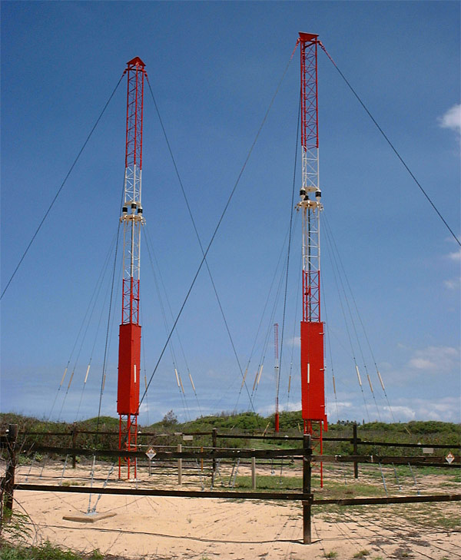
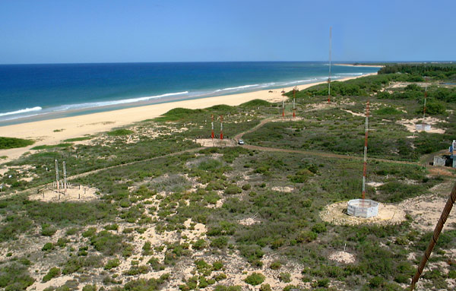
THE ANTENNAS · WWVH
Two towers, and a beam aimed at the Pacific
The array itself: two half-wave vertical elements, a quarter wavelength apart. Phase them and the pattern leans west.
The field they stand in. Left to right: the abandoned 20 MHz array, then 15 MHz, then 10 MHz — with the Pacific behind.
This is the photograph that settles the argument — NIST captions it as the array, element spacing and all.
Credit: NIST
Notes:
Point at the two towers. Everything on the previous slide is visible here: two elements, equal height, spaced a quarter wavelength, fed out of phase.
Give the wide shot a moment too. That abandoned 20 MHz array on the left is exactly why the sources disagree about which frequency carries the directional pattern - the field has changed over the years.

Slide 20
THE TRANSMITTERS
Who built the transmitters
Both stations run one transmitter per frequency, with standby units behind them. The hardware has been replaced far less often than you might expect.
WWV — FORT COLLINS
WWVH — KAUAI
TMC, then CCA
AEL, then Elcom-Bauer
1966 — Technical Materiel Corporation of Mamaroneck, New York, low bidder at $297,000: two GPT-40K sets at 10 kW, two GPT-10K sets at 2.5 kW, and two broadband standby sets able to run any WWV frequency.
1990 — new 10 kW transmitters for 5, 10 and 15 MHz from CCA Corporation. The TMC sets were reconfigured to 2.5 kW and kept as standby.
The original GPT-10K pair ran continuously until 2008 — forty-two years.
1971 — seven transmitters built by AEL Corporation went in when the station moved from Maui to Kauai.
1983 — two of them were pulled and three more efficient Elcom-Bauer units took their place.
Today: three Elcom-Bauer at 10 kW on 5, 10 and 15 MHz; one AEL at 5 kW on 2.5 MHz; and four AEL standby sets at 5 kW each.
Fifty-five years of service from four manufacturers, and a good deal of the original iron is still in the building.
Notes:
Four names carry the whole history: TMC and CCA at Fort Collins, AEL and Elcom-Bauer at Kauai.
The detail that lands with an engineering crowd is the forty-two-year run. A pair of TMC GPT-10K transmitters went on the air in 1966 and were still doing the job in 2008 - broadcast service, twenty-four hours a day, no programme breaks.
⚠️ One source conflict, if asked: NIST's own publication SP 250-67 names CCA Corporation for the 1990 replacements. A TMC collectors' history page says 'replaced by Continentals, I believe' - hedged, and secondary. Go with CCA and say NIST is the source.
NIST has not published what replaced the 2008-retired GPT-10Ks, so do not guess on stage.

Slide 21
THE TRANSMITTERS
At what power?
Radiated power, frequency by frequency. Each figure is one transmitter feeding one antenna.
FREQUENCY
WWV · FORT COLLINS
WWVH · KAUAI
2.5 MHz
2 500 W
5 000 W
5 MHz
10 000 W
10 000 W
10 MHz
10 000 W
10 000 W
15 MHz
10 000 W
10 000 W
20 MHz
2 500 W
not broadcast
25 MHz (experimental)
2 500 W
not broadcast
Put that beside your own station.
Ten kilowatts is roughly seven times the U.S. amateur legal limit — and it is run into a single half-wave vertical, twenty-four hours a day, with no programme to interrupt it.
Notes:
Point at the asymmetry on the top row: WWVH runs twice WWV's power on 2.5 MHz - 5 kW against 2.5 kW - because it is covering open ocean rather than a continent.
WWVH does not transmit on 20 or 25 MHz at all. Only Fort Collins does.
The 25 MHz outlet is experimental. It left the air in 1977 and came back in 2014, and NIST has always been explicit that it carries no guarantee of continuity.
The comparison at the bottom usually gets a reaction from a ham audience: 1500 W PEP is the U.S. limit, so 10 kW is about seven times that - continuous, not peak.

Slide 22
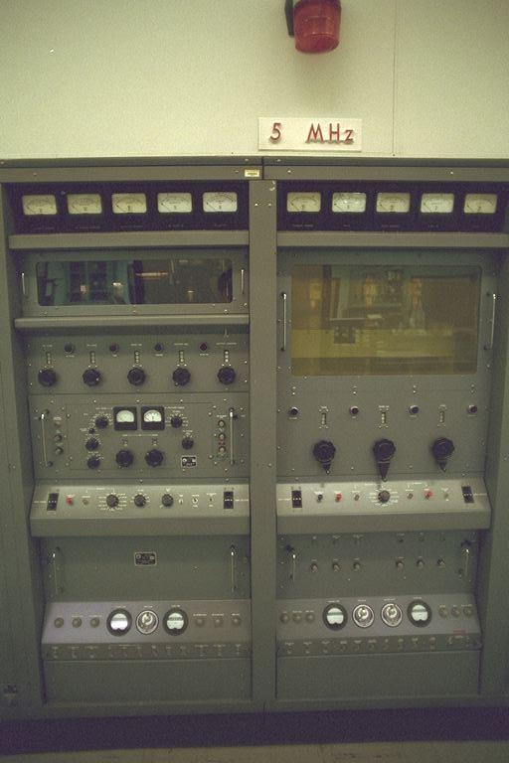
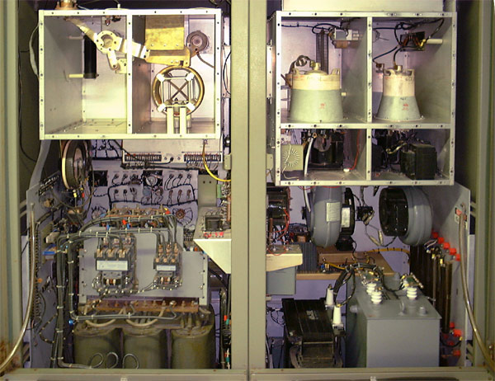
INSIDE THE TRANSMITTERS
Ten kilowatts, with the doors open
Fort Collins. The 5 MHz transmitter — one of the 10 kW units, front panel, meters and all.
Kauai. Inside a 10,000-watt Class C plate-modulated transmitter. Tubes, tank circuits and transformers you can point at.
Nothing here is miniaturised. This is broadcast iron, run continuously, and much of it is older than most of the audience.
Credit: NIST
Notes:
The open cabinet is what people photograph. Plate-modulated Class C is a design any operator who has been around AM will recognise instantly.
If someone asks why it is so big: at 10 kW continuous into a single frequency, thermal margin matters far more than size, and the design predates solid state entirely.

Slide 23
THE ANTENNAS
And then there is the 60 kHz problem
A quarter wavelength at 60 kHz is about 1,250 metres. Nobody builds that. WWVB's towers are 122 metres — roughly a tenth of what the physics wants.
capacitance “top hat”
How they make it work
downlead
A cable “top hat” slung between the four towers adds capacitance the short antenna lacks.
A helix house underneath holds a huge inductor to cancel that capacitance, plus a variometer to tune it.
Two identical antennas, 857 m apart, both built in 1962 and refurbished in 1999.
The north one was built for WWVL on 20 kHz — when that closed in 1972 the antenna was kept.
helix
four 122 m towers in a diamond
51 kW of forward power from each transmitter — to put 70 kW of effective radiated power in the air.
Notes:
People remember this antenna slide, because the numbers are absurd in a way anyone who has built an antenna immediately feels.
At 60 kHz a full wavelength is five kilometres. A proper quarter-wave radiator would be over a kilometre tall. WWVB's towers are 122 metres - about a tenth of that - so electrically the antenna is tiny, and everything else on this slide exists to compensate for that.
The top hat adds the capacitance a short antenna does not have. The helix house cancels it again with an enormous inductor and trims it with a variometer. The result is roughly 68.8 per cent efficient, which for an antenna a tenth of the right size is remarkable engineering.
And the north antenna is a leftover: built for WWVL on 20 kHz, kept when that station closed in 1972, and pressed into service for WWVB.

Slide 24
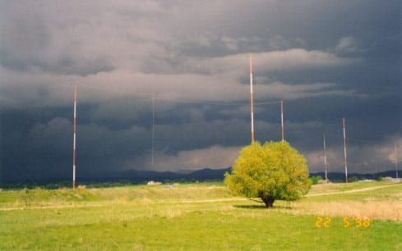
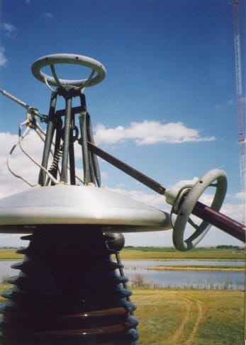
THE 60 kHz ANTENNA
Four hundred feet, to fake four thousand
The towers across the field. Four 400-foot towers hold up one antenna system, and there are two of them, 2,810 feet apart.
Busing on top of the helix house — the insulator and hardware where the power leaves for the down lead.
A true quarter wave at 60 kHz would stand 4,100 feet tall. Nobody builds that. The top-hat and the helix house stand in for the missing height.
Credit: NIST
Notes:
Point out what is actually radiating. It is not the towers - they are only there to hold up the cables. The radiator is the vertical down lead in the middle, and the diamond of cables overhead is the capacitive top hat.
The hardware shot gives the scale. That insulator is carrying the full output of the transmitter.

Slide 25
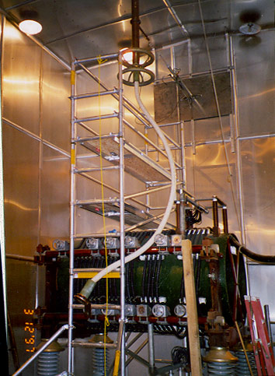
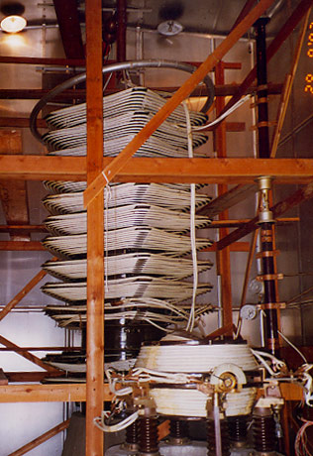
INSIDE THE HELIX HOUSE
The coil that makes an impossible antenna resonate
The helix house near completion. The white down lead is not yet connected to the antenna matching equipment.
The old antenna tuning variometer, now retired. Moving it changes inductance to hold the antenna in tune.
The antenna is electrically far too short, so it looks capacitive. The helix house supplies the inductance that cancels it out.
Credit: NIST
Notes:
Loading coils click here for anyone who has ever tuned a short vertical on 160 metres. Same problem, same solution, about four orders of magnitude apart in size.
Give the variometer a sentence: ice, wind and temperature move the antenna's electrical length all day, so the match has to move with it. On WWVB that is done automatically by a feedback loop from the transmitter.
The second photograph is retired equipment - the coil that did this job before the 1997-2000 rebuild.

Slide 26
WWV
WWV: the oldest voice on the air
On the air since 1920 — the world's longest continuously operating radio station.
Older than the entertainment broadcasters whose band it sits above.
1923
Already sending standard-frequency signals to the public, so the booming new radio industry could calibrate its gear.
1945
Carrying official U.S. time, maintained jointly by NIST and the U.S. Naval Observatory.
(303) 499-7111
And you can still simply phone the time.
Notes:
Read the phone number out and pause. Somebody always dials it, and it still answers.
Dwell on 1920 - KDKA's famous election-night broadcast was the same year. WWV is as old as broadcasting itself and has never stopped.

Slide 27
WWV
Where WWV has lived
1920
1931
1966
Washington, D.C.
suburban Maryland
Fort Collins, Colorado
on the air
a series of sites
its present home
A century in three places — and it very nearly ended in the fourth.
In 2018 the plan was to switch it off altogether. That story is the next slide.
Notes:
Three places in a century, and the room usually reacts to how short the list is. Washington from 1920, suburban Maryland from 1931, Fort Collins since 1966.
⚠️ Do not tell the 2019 story here - the last line of the slide deliberately hands it to the next one. Read that line, pause, and turn the page. The story lands harder with the numbers in front of them.

Slide 28
2018
The year it almost ended
In August 2018 the amateur community learned that NIST's Fiscal Year 2019 budget request proposed shutting down WWV and WWVH.
$6.3M
$629M
~1%
the saving proposed
the total NIST request
of the agency's budget
A century of continuous transmission, and the world's oldest radio station, came down to roughly one percent of one agency's budget.
And then people wrote in.
Hams, mariners, timekeepers and clock-watchers objected loudly. The ARRL raised the alarm, the shortwave community campaigned, Congress preserved the money — and by March 2019 the funding was restored. WWV reached its centenary the following year.
Notes:
Slow down here, because the people in front of you are the constituency that saved it. Ordinary operators wrote to their representatives and it worked.
NIST's justification was consolidation - the wider Fundamental Measurement budget was facing a $49 million reduction, and the stations were an obvious line to cut. The counter-argument that carried was not sentiment: it was that WWV and WWVH are a national reference used by aviation, marine, calibration and emergency users who have no equivalent fallback.
Worth saying plainly: it could come back. Nothing about this is permanently settled, and CHU shows what happens when nobody objects in time.

Slide 29
WWV
The frequency that came back
1977
NIST drops both the 20 and 25 MHz outlets
1978
20 MHz returns the following year
37 years
25 MHz stays dark
2014
A listener's emailed request prompts WWV's lead engineer to switch it back on
“For old times' sake,” on an experimental basis — and it has lived on intermittently ever since, useful mainly as a propagation beacon for 10 and 12 metres.
Notes:
People repeat this story afterwards. One listener sent an email, and a station that had been dark for thirty-seven years came back.
It was never restored to the official continuous lineup, which is why the published frequency list stops at 20 MHz. If you have heard 25 MHz, you have heard something that officially is not there.

Slide 30
WWV
Two favourite footnotes
1958
2021
Tracking a dying Sputnik
A deliberate burst of noise
WWV's 20 MHz signal was used to track Sputnik 1 by meteor-scatter, after the satellite's own electronics had failed.
Once an hour, WWV and WWVH carry an odd burst of tones, chirps and noise — a joint experiment with the ham-radio HamSCI project to study the ionosphere.
If you have ever heard something strange on WWV and assumed your receiver was faulty — it probably was not.
Notes:
The Sputnik story is the best one in the talk. The satellite's transmitter had died, so its position was worked out from how WWV's signal scattered off the ionised trail it left.
The HamSCI experiment is live and ongoing - anyone in the room with an HF receiver can contribute observations to it.

Slide 31
STILL TRANSMITTING
Around the world today
DCF77
Mainflingen, Germany
LF — 77.5 kHz
PTB, since 1959. Sets most of Central Europe's clocks; now also carries civil-protection alerts and weather data.
MSF
Anthorn, England
LF — 60 kHz
“Time from NPL.” Moved here in 2007 from its historic home at Rugby.
JJY
Fukushima & Kyushu, Japan
LF — 40 & 60 kHz
Two NICT stations covering all of Japan, on the same 40/60 kHz pair used by clock chips elsewhere.
BPM
Pucheng, China
HF — 2.5, 5, 10, 15 MHz
China's National Time Service Center, with longwave sister BPC on 68.5 kHz.
RWM
Moscow, Russia
HF — 4996, 9996, 14996 kHz
Continuous Morse-and-markers standard frequency. Russia also runs longwave RBU.
ALS162
Allouis, France
LF — 162 kHz
Rides the old France Inter longwave transmitter — the programming ended in 2016, the time signal did not.
Also on the air at various times: YVTO (Venezuela), HLA (South Korea), ATA (India), LOL (Argentina), BSF (Taiwan).
Notes:
The ALS162 story is the odd one: France's time code rides a longwave transmitter whose radio station shut down in 2016. The programming stopped, the carrier did not.
DCF77 carrying civil-protection alerts is a modern twist - a 1959 time station repurposed as an emergency channel.

Slide 32
A CLOSER LOOK
JJY: Japan's century of timekeeping
On the air 30 January 1940 — the world's second national standard-frequency station, behind only WWV. For most of its life it was a shortwave broadcaster as familiar across the Pacific as WWV itself.
1940
Late 1950s
1999–2001
Shortwave begins
The international set
Down to longwave
4, 7, 9 and 13 MHz
2.5, 5, 8, 10 and 15 MHz
40 kHz, then 60 kHz
That 8 MHz channel was a JJY signature — most of the world's time stations skipped it. The shortwave service signed off for good on 31 March 2001.
A Japanese woman's voice announced the time before every tenth minute: “JJY JJY 1630 JST.”
Notes:
Japan moved its time service down in frequency for the same reason everyone else did - longwave is steadier, less interference-prone, and far better for the radio-controlled clocks that were spreading nationwide.
An experimental longwave transmitter, JG2AS, had actually been running at 40 kHz since 1966, so the groundwork was thirty years old before the switch.

Slide 33
WHAT WE HAVE LOST
Silent now
CHU
Ottawa, Canada
HF — 3330, 7850, 14670 kHz
2026
Loran-C
U.S. & worldwide
LF — 100 kHz
2010
HBG
Prangins, Switzerland
LF — 75 kHz
2011
JJY (HF)
Japan
HF — 2.5 to 15 MHz
2001
VNG
Llandilo, Australia
HF
2002
Omega
worldwide, 8 stations
VLF — ~10–14 kHz
1997
OMA
Liblice, Czechoslovakia
LF — 50 kHz
1995
WWVL
Fort Collins, CO
VLF — 20 kHz
1972
Several were retired as satellite navigation made a steady terrestrial reference seem less essential — though jamming and indoor reception keep the old stations relevant.
Notes:
Read the years down the right-hand column and let the pattern show itself. Most of these went in the GPS era, on the argument that a terrestrial reference was no longer needed.
That argument has aged badly. GPS jamming and spoofing are now routine, and a signal that works indoors and cannot be trivially denied looks a great deal more valuable than it did in 1997.

Slide 34
WHAT WE HAVE LOST
The newest loss
CHU — Ottawa. Switched off 22 June 2026.
Canada's official time signal for more than a century, and the shortwave neighbour North Americans knew best after WWV.
Bilingual
English and French voice announcements
Unusual signal
Reduced-carrier single sideband, not the plain AM of WWV
Why it went
A budget measure by the National Research Council
What is left
Telephone, a web clock, and network time protocol
Notes:
For a North American audience this is the emotional centre of the talk. A great many people in the room will have heard CHU without ever thinking about it, and a fair few will not know it has gone.
Official Canadian time now goes out only by telephone, web and NTP - all of which require an internet connection to reach you - a different kind of dependency from a signal in the air.

Slide 35
THE LAST VOICES
Who is still speaking?
With CHU gone, a natural question: is anyone else out there still announcing the time in a human voice?
WWV
Fort Collins
English, male
ON THE AIR
WWVH
Kauai
English, female
ON THE AIR
YVTO
Caracas
Spanish
REPORTED ON AIR
CHU
Ottawa
English & French
SILENT 2026
JJY (HF)
Japan
Japanese, female
SILENT 2001
BPM, RWM and every longwave station send tones, Morse or code — no voice at all.
Notes:
The precise answer, because it is better than the simple one: WWV and WWVH are almost certainly the last ENGLISH-language voice time stations, now that CHU has gone. They are not the last voice stations outright - YVTO in Caracas announces the time in Spanish.
One honest caveat: YVTO's current operating status is hard to confirm from here. Venezuela's infrastructure has been unreliable and reception reports are sporadic. If you have heard it recently, you know more than the references do.
Everything else still transmitting - BPM in China, RWM in Russia, and all the longwave stations - sends tones, Morse or a bare code. No human voice anywhere in them.

Slide 36
WHAT THEY ARE FOR US
Why amateur radio has always leaned on them
Every one of these uses comes from the same property: a time station is the one signal on the band whose frequency, timing and behaviour you can trust absolutely. That makes it a measuring stick for everything else.
1
Calibrating the rig
Zero-beat against a carrier that is right to a fraction of a part per billion. Before cheap frequency counters, this was how you knew where your VFO actually was.
2
Reading the band
If 15 MHz is booming and 20 is silent, the band has told you something. WWV's intermittent 25 MHz outlet survives mainly as a propagation beacon for 10 and 12 metres.
3
Space weather, hourly
WWV carries geophysical and GPS-status announcements every hour — propagation information delivered by the same signal you are using to judge propagation.
4
Knowing the time that matters
UTC, spoken aloud, for logs, schedules, nets and contests — with no clock of your own to trust or set.
5
Doing science with it
Since 2021 WWV and WWVH carry an hourly burst of tones and noise for the HamSCI ionospheric experiment. In 1958 the 20 MHz signal tracked a dying Sputnik by meteor-scatter.
Notes:
Here is the answer to 'why should I care' for a ham audience, so do not rush it.
The calibration point is generational. Anyone in the room who was licensed before frequency counters got cheap learned to zero-beat against WWV, and most of them still remember the sound of doing it.
The propagation point still earns its keep every single day - tuning across 2.5, 5, 10, 15 and 20 MHz and noting which ones you can hear is a complete band report in about thirty seconds, using nothing but your ears.
And the last one matters for recruitment: HamSCI is live and open. Anyone with an HF receiver can contribute observations to real ionospheric research using a station that has been on the air since 1920.

Slide 37
WHAT REPLACED THEM
So what is the standard now?
UTC is the world's time standard — and always was.
Coordinated Universal Time, kept by international agreement from atomic clocks in national laboratories. The time stations never were the standard — they were one way of delivering it.
What changed is the delivery:
GPS
NTP
The old way
Global Positioning System
Network Time Protocol
A carrier in the air
A satellite constellation carrying atomic clocks. Your receiver works out where it is from how long each signal took to arrive — so it is a timing system first and a navigation system second.
How almost every computer and phone on earth sets its clock, over the internet, without anyone thinking about it.
A signal you can receive with a wire and a diode, from a transmitter you can point at on a map.
GPS did not replace the time stations with a better time signal. It replaced them by putting an atomic clock in everyone's pocket for the price of a chip.
Notes:
The distinction that matters and almost nobody makes: UTC is the standard. WWV, GPS and NTP are all just delivery mechanisms for it. Losing a time station does not change what time it is - it removes one independent way of finding out.
Define GPS properly because people think of it as a map system. Every satellite carries atomic clocks and broadcasts what time it thinks it is; your receiver compares several of those and derives both position and time. Position is a by-product of timing, not the other way round. A GPS receiver is, functionally, a very cheap atomic clock.
That is genuinely why the terrestrial stations were retired: not because the signal was worse, but because the alternative got absurdly cheap.
Then set up the closing: ask the room what happens to all three columns when the internet is down or the GPS band is jammed. Only one of them still works.

Slide 38
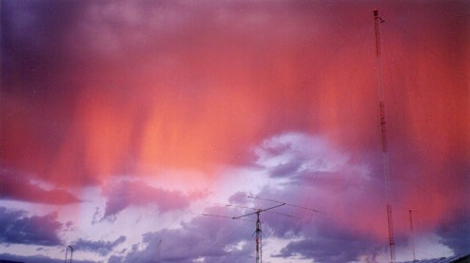
WHY THEY STILL MATTER
A signal in the air needs no account,
no subscription and no network.
It simply arrives.
GPS can be jammed. The internet can be down. A satellite constellation is operated by somebody, somewhere, who can switch it off. A carrier on 60 kHz just arrives — and every station that closes is one fewer way to know what time it is without asking permission.
Questions?
Credit: NIST
Notes:
Close on the idea rather than the facts. Every other timing source in modern life - GPS, NTP, your phone - depends on infrastructure that can be denied, jammed, billed for, or switched off remotely.
A carrier on 60 kHz just arrives. That counts for something, and it counts for more now than it looked in 1997.

Slide 39
TAKE THIS AWAY
Where to read the detail
Everything in this talk is written up at greater length, free, with no sign-up and nothing for sale.
Time Stations
The full version of this talk, with every station listed
Shortwave from America
U.S. international broadcasters, past and present
AM Broadcast Band Trivia
The other end of the dial
NIST Time and Frequency Division
The official source for WWV, WWVH and WWVB
n6jet.com
Notes:
This slide is here for your audience, not for anybody's credit. Leave it in if your club will want the written detail, delete it if not - no attribution is required anywhere in this deck.

